Slide 1
EDA Capstone Project
EDA ON AIRBNB BOOKING ANALYSIS
TEAM :
MANIKARAN RAYAPURAM

Slide 2
What is Airbnb ?
Airbnb (ABNB) is an online marketplace that connects people who want to rent out their homes with people who are looking for accommodations in specific locales.
The company has come a long way since 2007, when its co-founders first came up with the idea to invite paying guests to sleep on an air mattress in their living room.
Airbnb is an online marketplace that connects people who want to rent out their homes with people who are looking for accommodations in specific locales.
According to Airbnb's latest data, it has in excess of six million listings, covering more than 100,000 cities and towns and 220-plus countries worldwide.

Slide 3
Problem Statement
For this we have analyse Airbnb’s New York City (NYC) data of 2019. NYC not only most famous in the world but also top global destination for visitors drawn to its museums , entertainment , restaurants and commerce.
Our main objective is to find the key metrics that influence the listing of properties on the platform . For this , we will explore and visualize the dataset from Airbnb in NYC using basic exploratory data analysis(EDA) techniques .
Data analysis on thousands of listings provided through Airbnb is a crucial factor for the company .
We will find out the distribution of every Airbnb listing based on their location in NYC including their price range , room type ,listing name and other related factors .

Slide 4
Understanding of data
Id : Unique id
Name : Name of the listing
Host Id : Unique host id
Host Name : Name of the host
Neighbourhood Group : Location
Neighbourhood : Area
Latitude : Latitude range
Longitude : Longitude range
Room Type : Type of listing or Type of room
Price : Price of listing per night
Minimum Nights : Minimum nights to be paid for listing
Number Of Reviews : Number of reviews
Last Review : Date of last review
Reviews Per Month : Number of checks per month
Calculated Host Listing Count : Total count of listings
Avalability 365 : Avalability over the year

Slide 5
Agenda
We try to answer following questions for Airbnb :
What is the average preferred price of neighbourhood group to the location ?
What is the share of room types in each neighborhood group ?
Where the customers pay heighest and lowest rent according to the location ?
Most preferred room types by customers .
Find the total count of each room type .
Room types and their relation with avalability in different neighbouhood groups .
Find top 10 hosts with most listings .
Find top 10 hosts with most reviews .

Slide 6
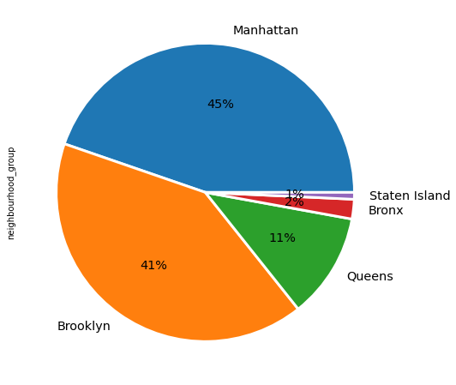
Various neighbourhood group and its listings
Manhattan has the heighest number of listings about 45% (21548 listings ) followed by Brooklyn of 41% (19748 listings) .
Staten island stands the least number of listings less than 1% (356 listings) .

Slide 7
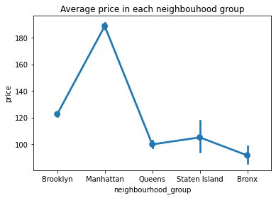
What is the average price for each neighbourhood group
Manhattan has the costliest place to live in NYC , having average price more than 180 USD followed by Brooklyn with around 120 USD on an average for the listing .
Queens and Staten Island has nearly of same of 100 USD .
Bronx has the cheapest place to live in NYC, having average price less than 90 USD for the listing .

Slide 8
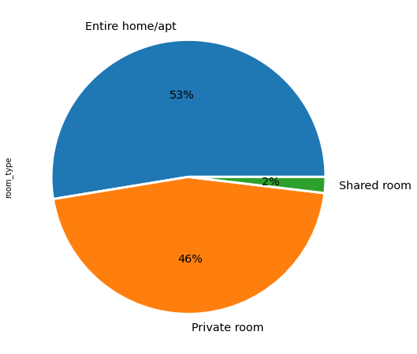
What is the share of various room types
The entire home/apt (53% or 25339 ) room are highest in NYC followed by private room (46% or 21935 ) .
Shared rooms holds are only 2% i.e 909 rooms in Airbnb NYC .

Slide 9
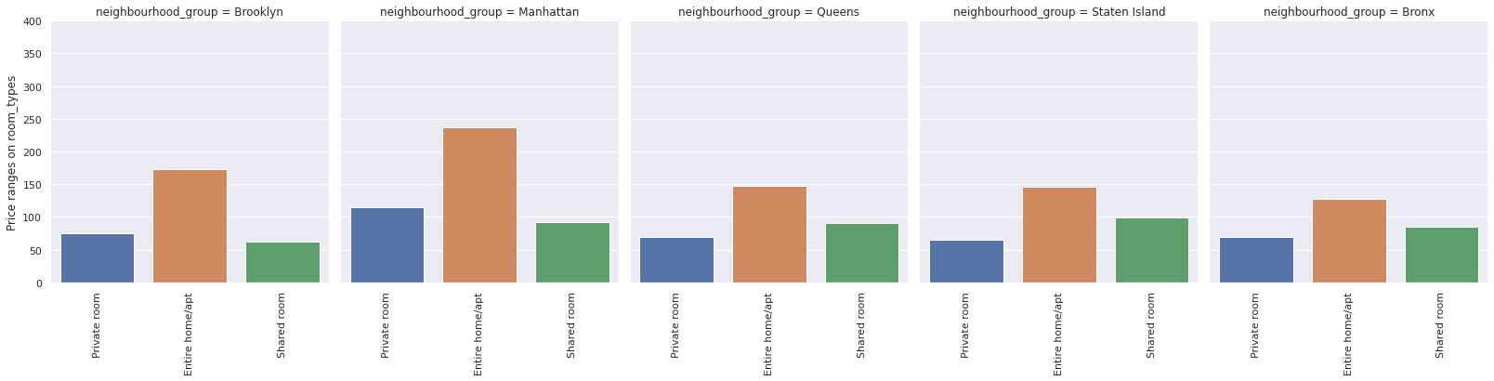
What is average cost of stay in different room type
Entire home may averagely costs 150 USD .
Private room average cost is of around 70 USD .
Share rooms average cost in manhattan and brooklyn is 55 USD .

Slide 10
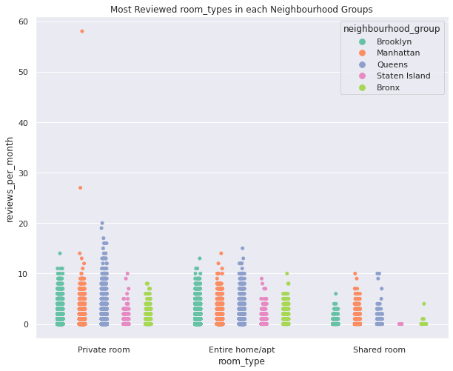
What room types are preferred in each neighbourhood group
Here we can conclude that private rooms in manhattan had highest number of reviews going 50+ reviews per month followed by the chase .
After manhattan , Queens had the highest number of reviews in all the room types .
There were less reviews received from shared rooms as compared to other room types and it was from staten island followed by brooklyn .

Slide 11
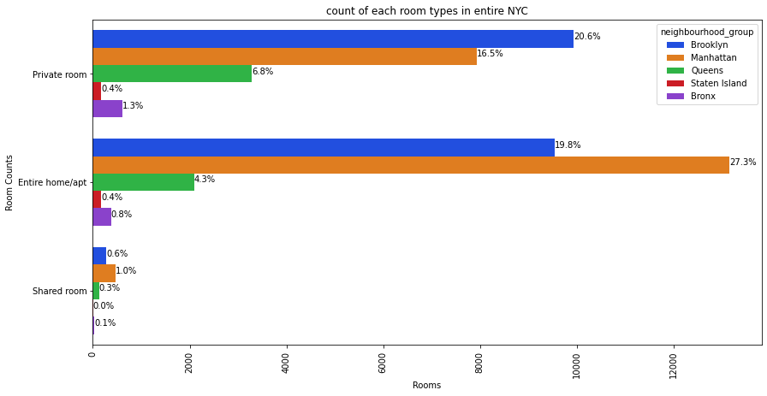
How much room types in neighbourhood group
Manhattan has the highest number of entire home/apt.
Brooklyn hold the top share of private rooms .
Staten island have equal percentage of private rooms and entire home/apt .
Also, we see that staten island has a smaller number of room types as compared to another neighbourhood.

Slide 12
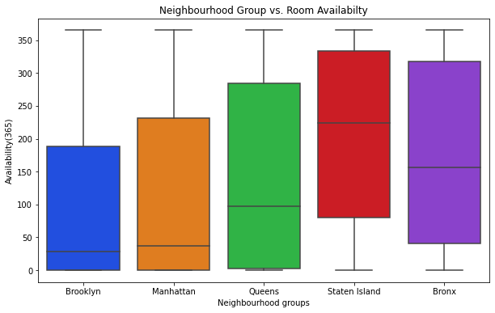
How much is availbility of rooms in neighbourhood group
Staten island has the most availabilty of rooms all the year .
Brooklyn having the least availability of rooms through the year with the second most count listing gives an opportunity to have increase in number of rooms .
Manhattan , Bronx and Queens has nearly equal availability of rooms through the year .

Slide 13
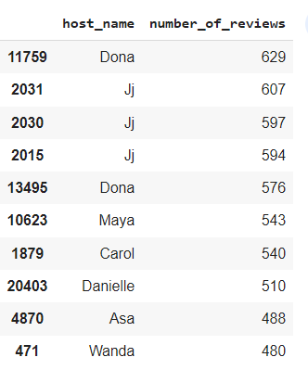
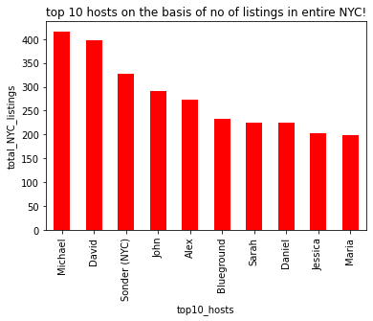
Top 10 hosts with listing count and reviews
Dina, Ji ,Maya and Carol has the maximum number of reviews .
Michael , david and Sonder NYC , John has the highest number of listing count .

Slide 14
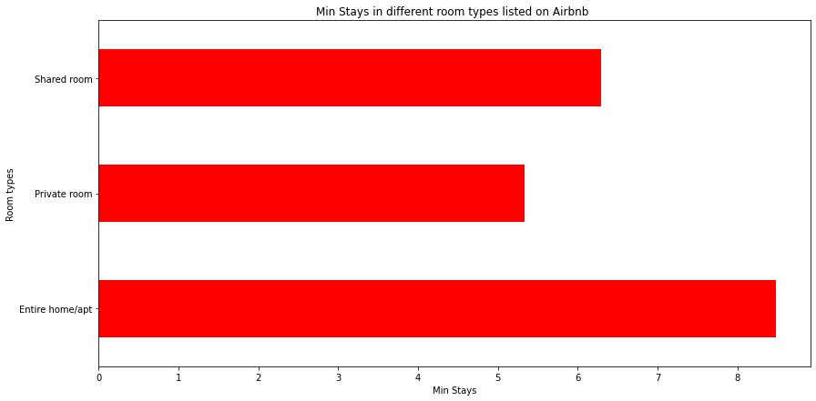
Total number of average minimum nights spend per room types
The average minimum nights in entire home/apt is greater than 8 days .
The average minimum nights in private rooms is greater than 5 days.
The average minimum nights in shared rooms is greater than 6 days.

Slide 15
Challenges Faced
Reading the dataset and understanding the columns .
For answering some of the questions we had to understand the business model of Airbnb that how they work .
Handling missing values , outliers and duplicates .
Designing the multiple visualizations to summarize the information in the dataset and successfully communicate the results and trends to the reader .
Finding and sorting few impossible dataset .

Slide 16
Points which can help Airbnb in their business
Manhattan is the most focused place in NYC for hosts to do their business .
As people loved to stay when in need for maximum number of nights in entire home/apt and Brooklyn is the second highest focused place by people .Also , average cost in brooklyn is 80 USD which is less than manhattan .
Top most place in neighbourhood is Williamsberg and Bedford.
Top rated hosts as per number of reviews are Drona and Ji.
The availability of rooms in a year is highest in staten island and lowest in Brooklyn .
So, it is great opportunity to increase some entire home/apt in brooklyn .

Slide 17
Thank You

